Slide 1

Computer Department Neighbouring Nurse
Prepared By
Guided By
Prof. A. R. Thaker
GPA
Aashi Shah | 196170307132
Mitali Sonar | 196170307142
Snehal Tadvi | 196170307146
Himani Trivedi | 196170307149
Diya Vora | 196170307155

Slide 2
Project Profile
Project Name:
Front End :
Back End :
Neighbouring Nurse
HTML, CSS,JS
PHP, Mysql

Slide 3

Neighbouring Nurse
We provide platform to nurses for giving their services at patient’s place at their suitable time.

Slide 4
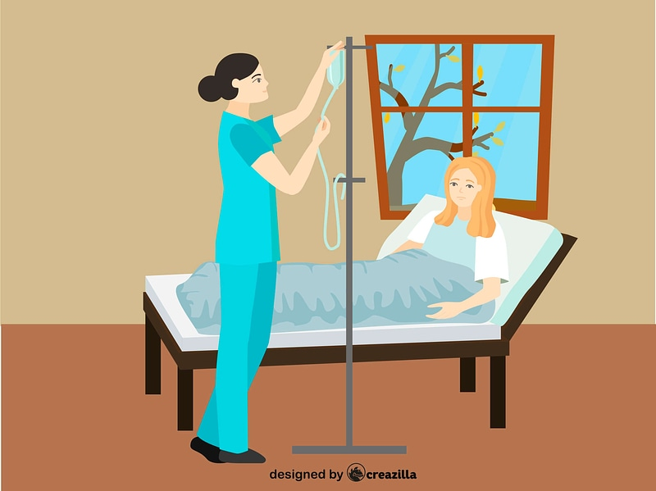
Patient can book a nurse from the system who is available at their service
time, location and at
affordable rate.

Slide 5
Literature Survey

Slide 6
Existing System
All the current system has its own hired nurses and they manually schedule the appointment of requested patients and provide their nurses to the patient’s home.

Slide 7
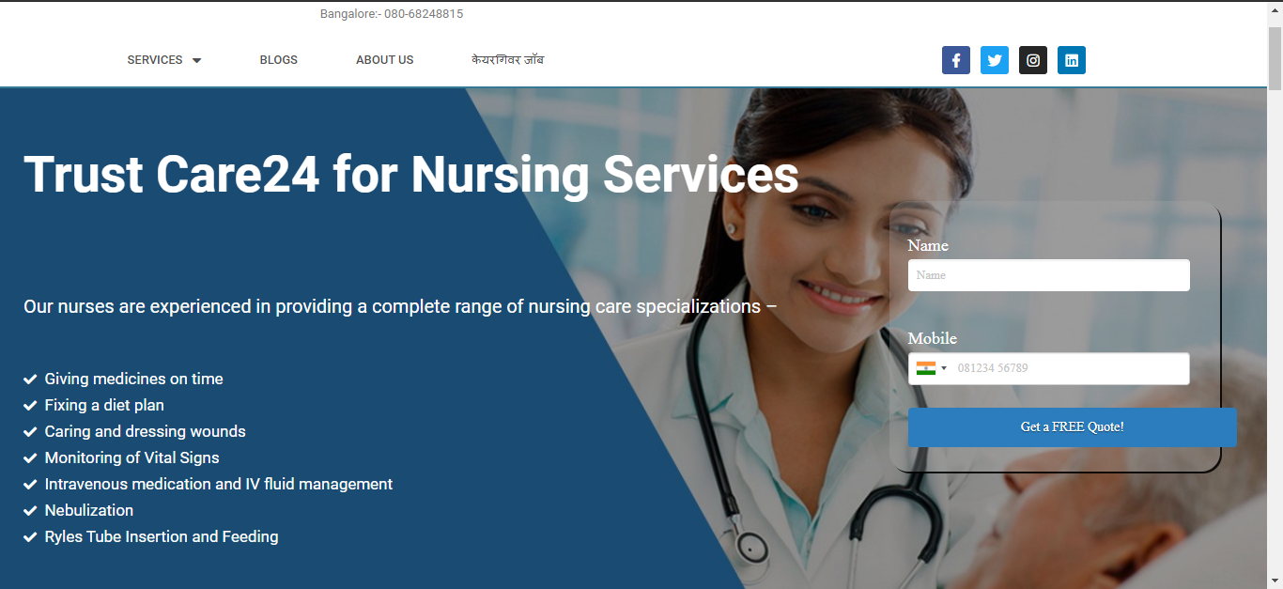
Care24 [https://care24.co.in/nursing]

Slide 8
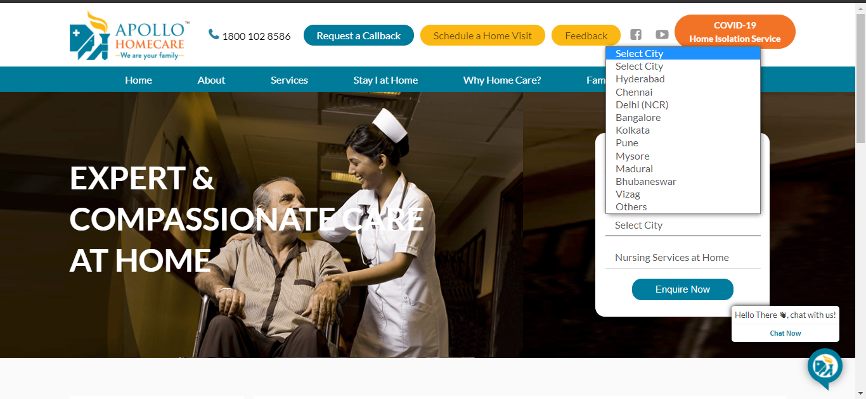
Apollohomecare [https://apollohomecare.com/services/home-nursing-programs/]

Slide 9
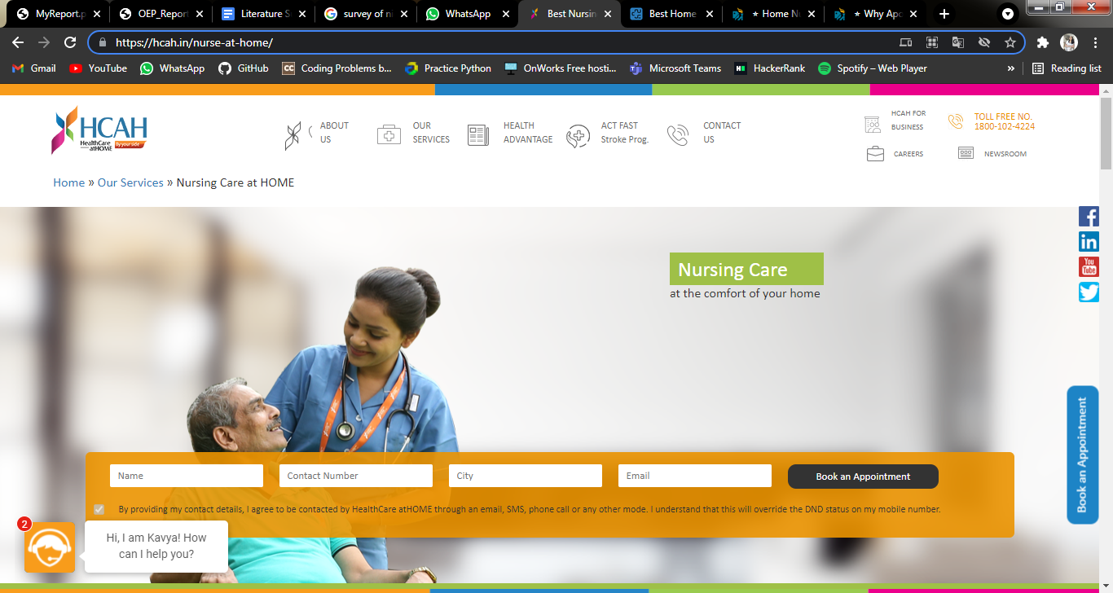
Healthcare at Home [https://hcah.in/nurse-at-home/]

Slide 10
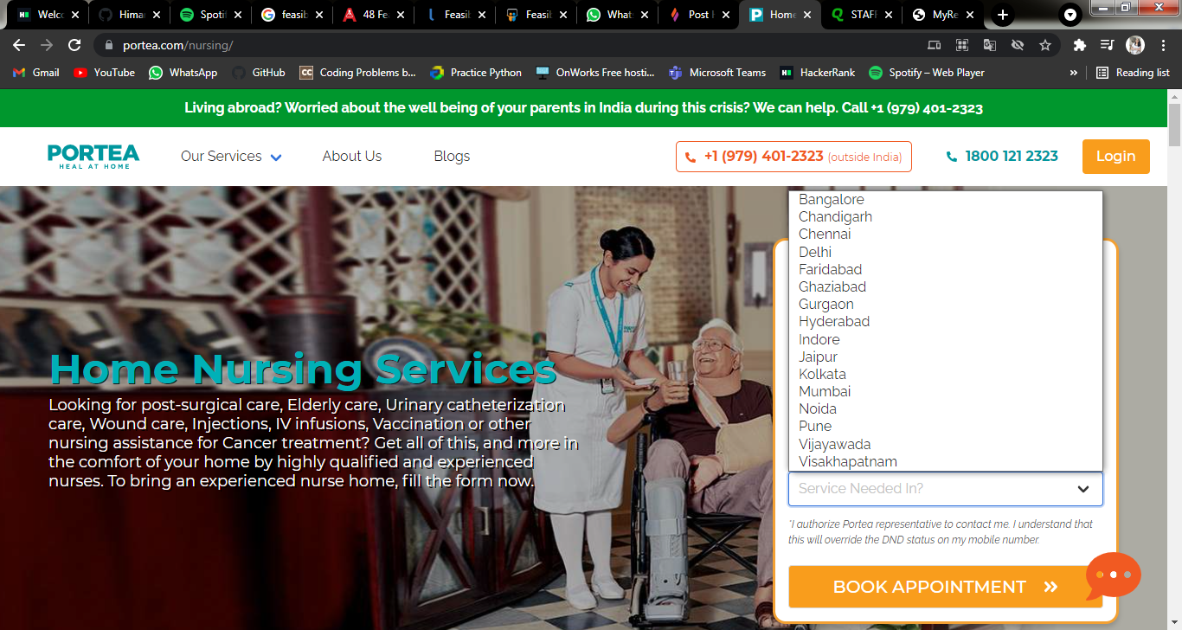
Portea Heal At Home [https://www.portea.com/]

Slide 11
Shortcomings
There is still manual.
Services are expensive.
To much time.
No one to one connection between nurse and patient.

Slide 12
Objective
We provide platform that employees nurses as per their convenience.
People gets more aware of hiring nurse online which saves their money as well as time.
Neighboring Nurse service provides healthcare services at your home.
We provide short term services that stops the frequent hospital visits.
We bring you experienced nurse.
Also proper care can be taken of an individual unlike hospitals.

Slide 13
Feasibility

Slide 14
Technical feasibility
Nurses must have active internet connection 24 X 7.
Both nurse and patient should allow for our system to send notifications in their browser.

Slide 15
Operational Feasibility
Nurse has to first accept the agreement for payment before creating an account.
Patients can easily search for nearby nurses, by selecting service, timing and providing the locality to the system.
Nurse will get to know whenever any user requests for service through notification.
User can do offline/online payment as per their convenience.
So, there is no extra skill required for using our system for both patient and nurse. So, it is operationally feasible too.

Slide 16
Roles and Responsibility

Slide 17
Admin
Admin can view the profile of the nurse to check his/her qualification.
If qualification meets the requirement, then admin will accept the nurse request or it will be denied.

Slide 18
Nurse
If Nurse agrees to the terms and conditions then she will be able to make profile.
If admin accepts the nurse's profile he/She has to pay 1000 as per agreement.
Nurse can withdraw the money online at any point of time.
Nurse will enter the area where she can provide service.
He / She will update their available time slots for service in profile every week.
He / She can accept or deny the request sent by user according to their satisfaction.

Slide 19
User
User will log-in the system so that he/she could request for a particular service.
User will search for nurse using a particular area, service.
User will send request to nurse along with a form that has all the details of patient and service to be provided.
User will pay for the service online/offline as per his convenience.
User can cancel the service any time if needed, but not before one hour of the service

Slide 20
Guest User
Guest user can view the user-based interface without login in.
Guest User are able to surf the user interface without login in.
But guest user will not able to book a service unless and until he/she logged in.
Guest User can view functionalities like short term service, search nurse by area.

Slide 21
Modules

Slide 22
Registration
Nurse
User
In registration page user can register himself/herself in the system for getting services by filling some details like email, name, age etc.
Same way nurse can register herself by accepting some policies and giving her details like name, email id, her experience.

Slide 23
Log-in
User
Admin
Nurse
Once user registered himself/herself then he can login in system from anywhere and on from any device.
Same applied to nurse also once she registered himself/herself then she can login in system from anywhere and on from any device .
The mail-id and password will directly provide to admin by system only, he/she just need to enter this and can login in system.

Slide 24
Notification
User
Admin
Nurse
In notification Page all the types of notifications will be appear.
Just as user, nurse will also get notifications like she got accepted for providing services, who sended her request etc
Admin will also get notification about the nurse who want to get register in system.

Slide 25
Patient Request Forms
Search
In search page user have to enter his/her location and what kind of service they want. Once user entered this it will show the list of nurse who will able to provide that service in that entered location.
This will contain request forms created by a patient/User. Here patients can create a new request form or choose an already created form for giving a request to a nurse.

Slide 26
Accepted Request This will contain all the accepted requests of the patient with a nurse with the appropriate current service status.
User
Nurse
With above, it also contains requested nurse info, its own request form, cancel & payment options to patients.
Addition to above, it also contains the cancel option, patient’s request form to nurse and payment conformation option.

Slide 27
Payment
Patient/User can do the payment in two ways:
Online: In this approach, patients will pay in our system account.
Offline: In this approach, the patient has to first select offline payment and then he/she will pay the invoice to the nurse.

Slide 28
Profile
Contact Us
User and nurse can view his/her profile and update their profile if needed .
If user/nurse find some problem/query while using website he/she can contact us from this contact page and tell us about his/her problem they face while using the website.

Slide 29
Nurse Wallet
Through this nurse can withdraw her earned money from the system account.

Slide 30
Thank You

